Slide 1
WISE Final Design Review Fall 2014
SLHS-VID
SLAC
Dining Services
EPICS Explorer

Slide 2
SLHS-VID
Jimmy Dixon
Matthew Pace
Ze An
Notes:
Introductions: Name, major, role. Jimmy will go last to transition to next slide.

Slide 3
PROJECT PARTNER
Department of Speech Language and Hearing Sciences (SLHS)
Contacts
Anu Subramanian
Clinical Associate Professor
Barbara Cicholski
Clinical Assistant Professor
Notes:
Jimmy

Slide 4
PROJECT OBJECTIVES
To design a web application to allow students of SLHS to practice administering speech therapy examinations
Support a variety of subjects and examinations
Provide dynamic feedback on the student’s administration of the exam, based on their choices
Notes:
Matt

Slide 5
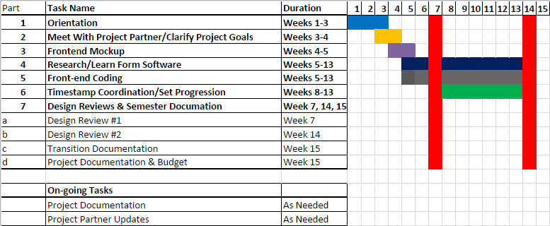
SEMESTER TIMELINE
Notes:
Ze: Talk about each part (to increase presentation time)

Slide 6
THIS SEMESTER
Initial meeting with Project Partners
Obtained a clear picture of partner’s needs
Clarified the scope of the project and team abilities
Developed mock-up and framework for website
Received approval of mock-up
Developed a prototype website with robust functionality
Video selection
Form slideout
Notes:
Ze: Mention that this project is new this semester, and that there is no budget

Slide 7
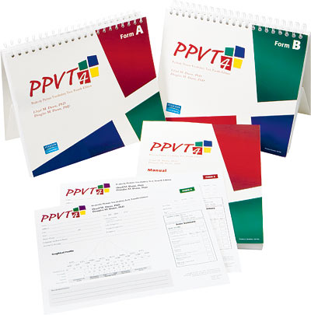
EXAMINATION BEING IMPLEMENTED
http://pearsonassess.ca/haiweb/Cultures/en-CA/Products/Product+Detail.htm?CS_ProductID=PPVT-4&CS_Category=educational-basic-skills&CS_Catalog=TPC-CACatalog
Notes:
Jimmy
The test is given verbally and takes from twenty to thirty minutes to complete. No reading is required by the individual, and scoring is rapid. For its administration, the examiner presents a series of pictures to each person. There are four pictures to a page, and each is numbered. The examiner speaks a word describing one of the pictures and asks the individual to point to or say the number of the picture that the word describes. Item responses can also be made by multiple choice selection depending on the age of the person being tested. The total score can be converted to a percentile rank, mental age, or a standard deviation IQ score. Although desirable, no special training is required to properly administer and score the PPVT-IV. The test publisher recommends that anyone interpreting or explaining the test scores should have knowledge in psychological testing and statistics.

Slide 8
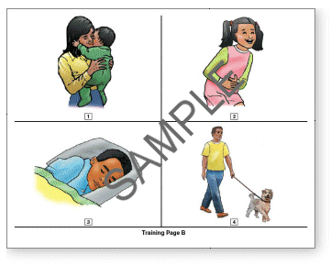
http://images.pearsonclinical.com/images/pa/ppvt4item.gif
Notes:
Jimmy

Slide 9
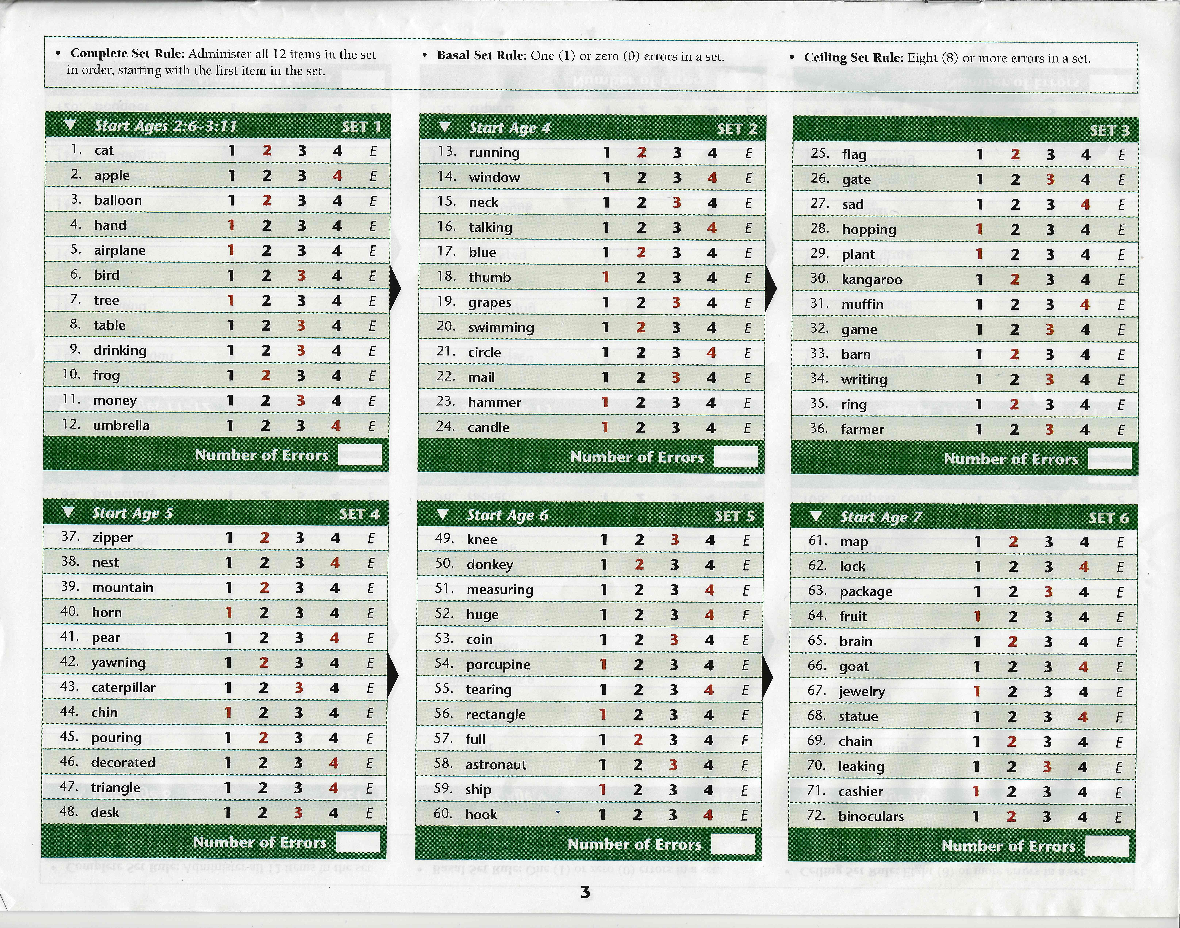
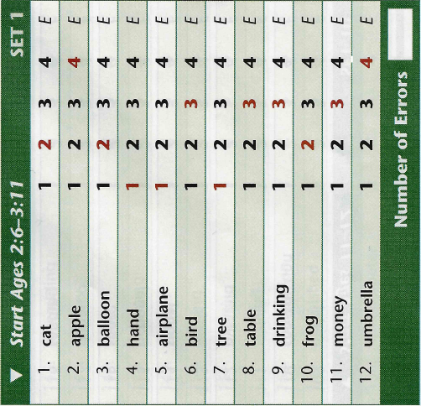
SETS FROM PPVT4
Notes:
Jimmy: The test is given verbally and takes from twenty to thirty minutes to complete. No reading is required by the individual, and scoring is rapid. For its administration, the examiner presents a series of pictures to each person. There are four pictures to a page, and each is numbered. The examiner speaks a word describing one of the pictures and asks the individual to point to or say the number of the picture that the word describes. Item responses can also be made by multiple choice selection depending on the age of the person being tested. The total score can be converted to a percentile rank, mental age, or a standard deviation IQ score. Although desirable, no special training is required to properly administer and score the PPVT-IV. The test publisher recommends that anyone interpreting or explaining the test scores should have knowledge in psychological testing and statistics.

Slide 10
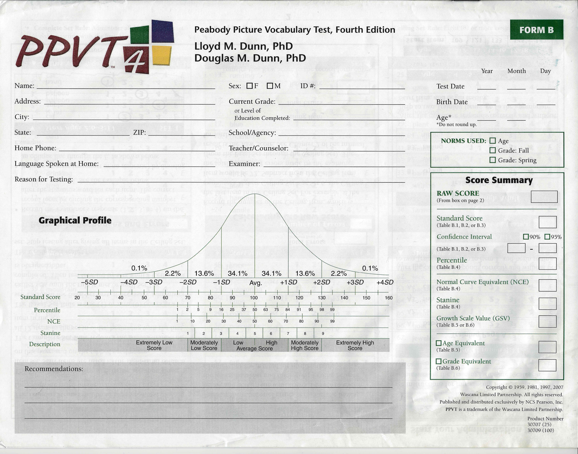
RESULTS PAGE
Notes:
Matt

Slide 11
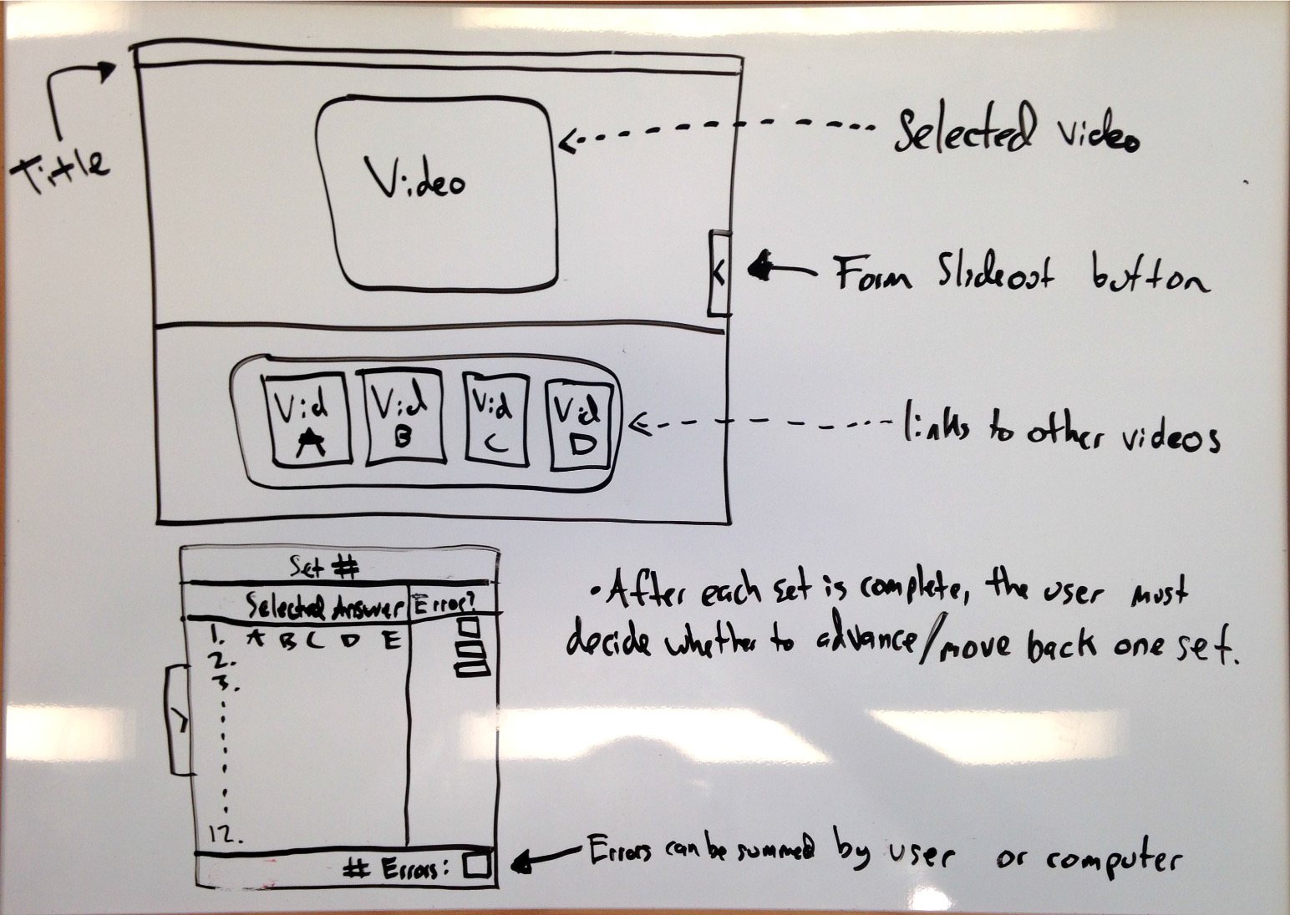
FRONT-END MOCKUP
Notes:
Matt

Slide 12
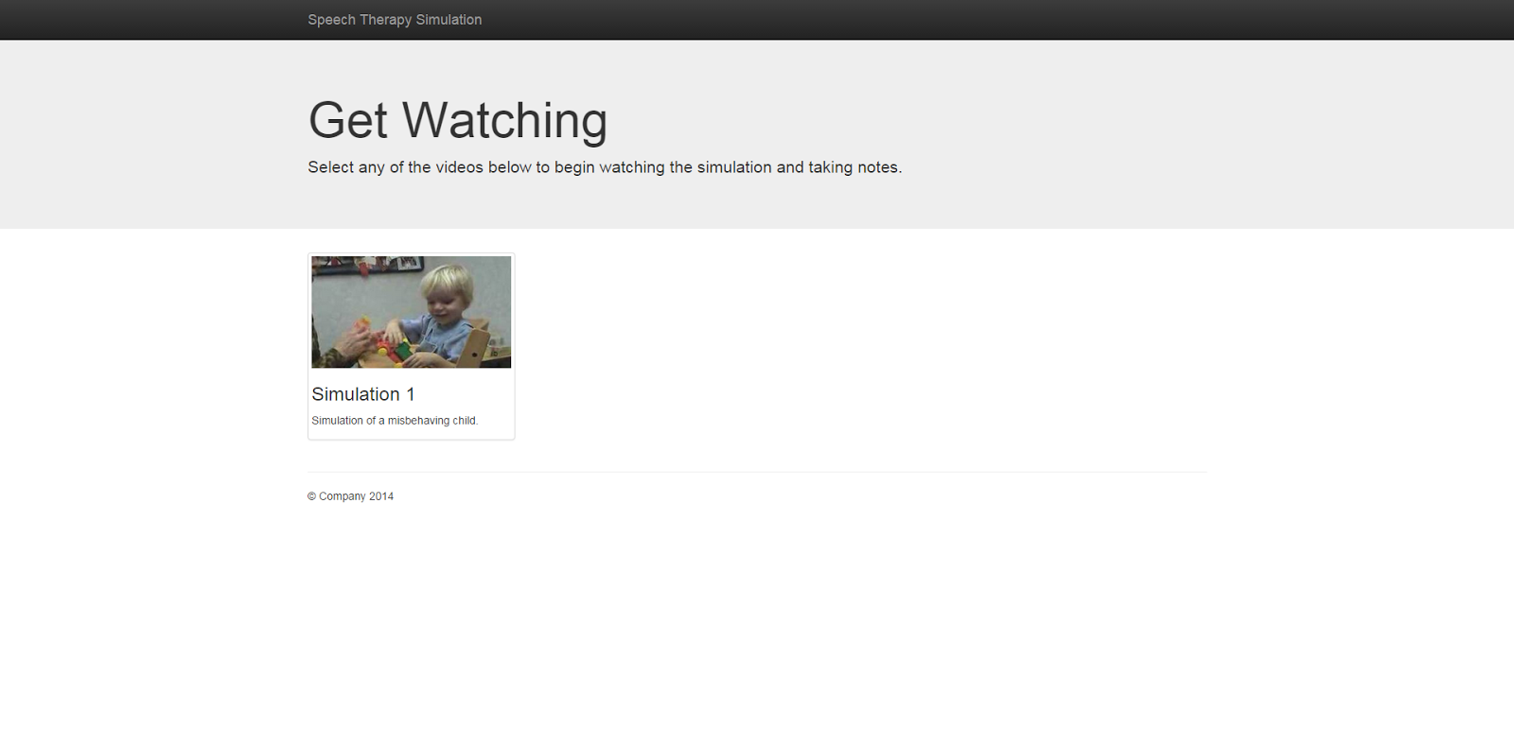
Notes:
Matt

Slide 13
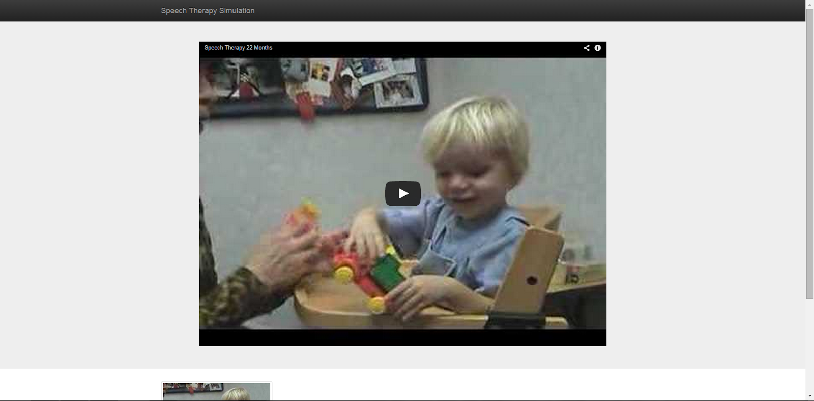
Notes:
Matt

Slide 14

Notes:
Matt

Slide 15
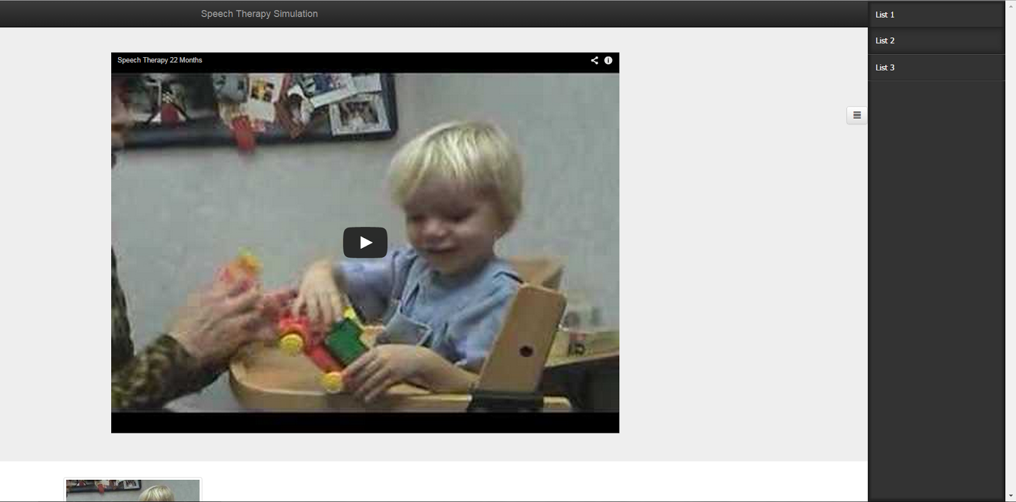
Notes:
Matt

Slide 16
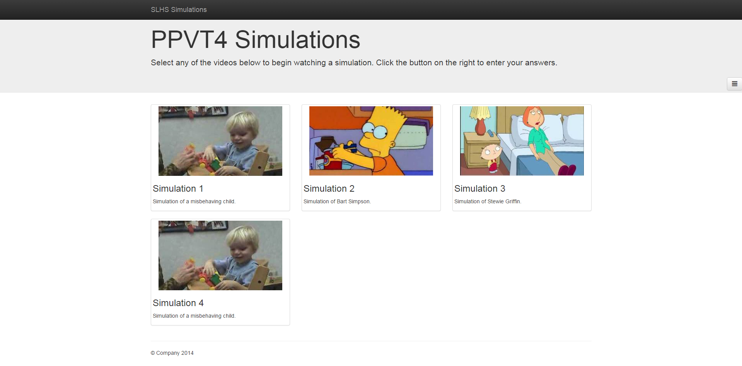

Slide 17
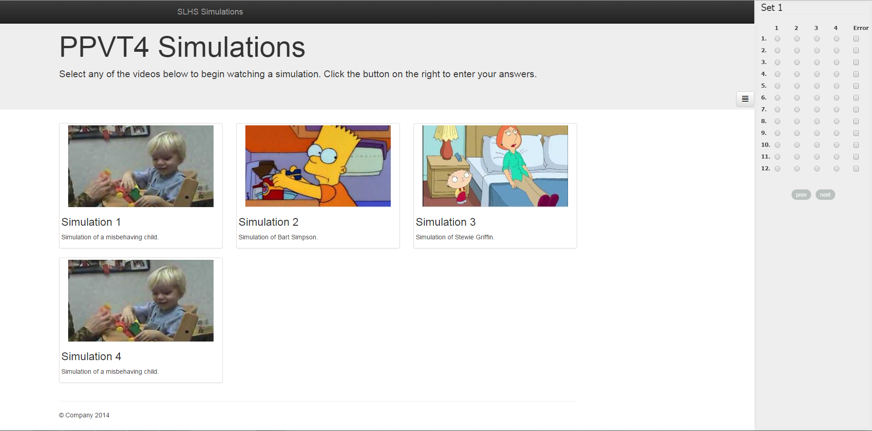

Slide 18
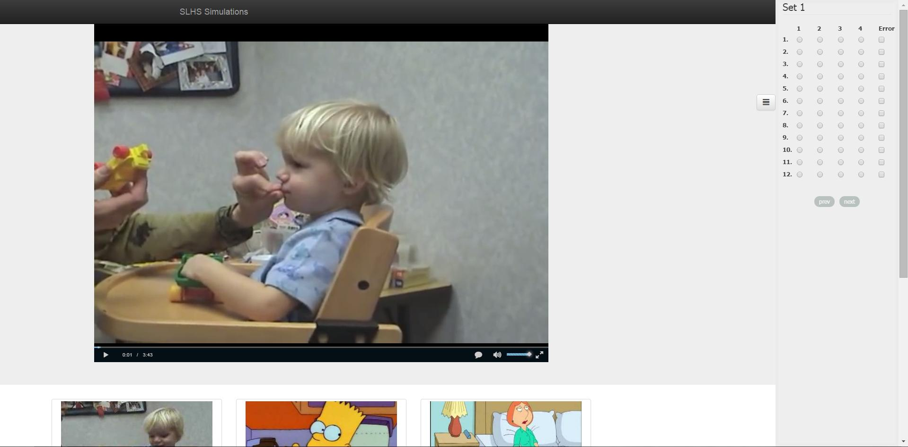

Slide 19
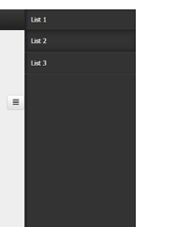
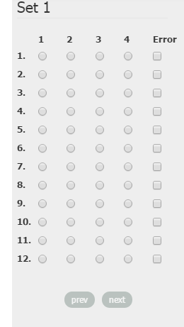
FORM IMPROVEMENTS

Slide 20
DEMONSTRATION
http://web.ics.purdue.edu/~an40/slhs-vid/

Slide 21
TECHNOLOGY
JavaScript/HTML/CSS
HTML5
Owl Carousel
Video.js
Bootstrap
jQuery
jQuery templates
Sidr
Notes:
Matt:
mention desktop only functionality: need for larger screen, having form overlay/obscure video does not accurately simulate the testing environment

Slide 22
SEMESTER GOALS
Fully implement the multiple choice and summary sections of the form
Implement timestamp/set progression functionality with video player
Notes:
Ze

Slide 23
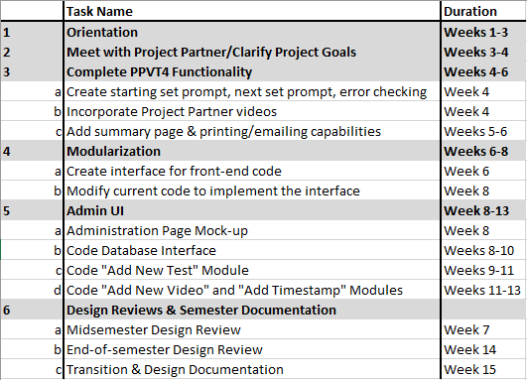
NEXT SEMESTER GOALS
Notes:
Ze
Modularize videos, test forms, and timestamps
Develop an admin module
Estimated delivery date: end of spring semster

Slide 24
Thank You!
Any Questions?

Slide 25
EPICS-SLAC
Henry Heim
Zhaowei Liang
Deep Randhawa

Slide 26


EPICS Explorer
Project Partner
Roberta Williams

Slide 27
GOAL
To provide a visual simulation for audiology students to practice testing different types of hearing loss and give real test.

Slide 28
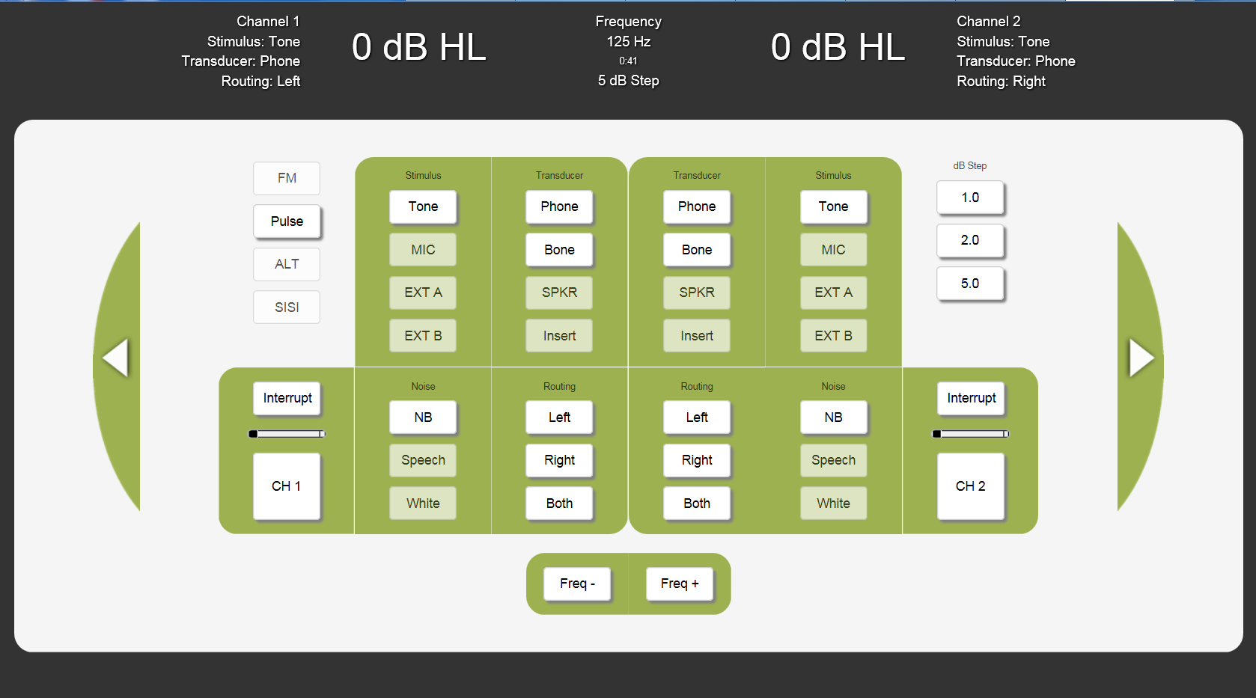
What we inherited

Slide 29
What we inherited
Unnecessary buttons
Small text in header
Channels are confusing
Not everything is functional

Slide 30
What we’re focusing on
Minor layout tweaks
Adding necessary functionality
Small user-friendly tweaks
Making code programmer-friendly
Database implementation

Slide 31
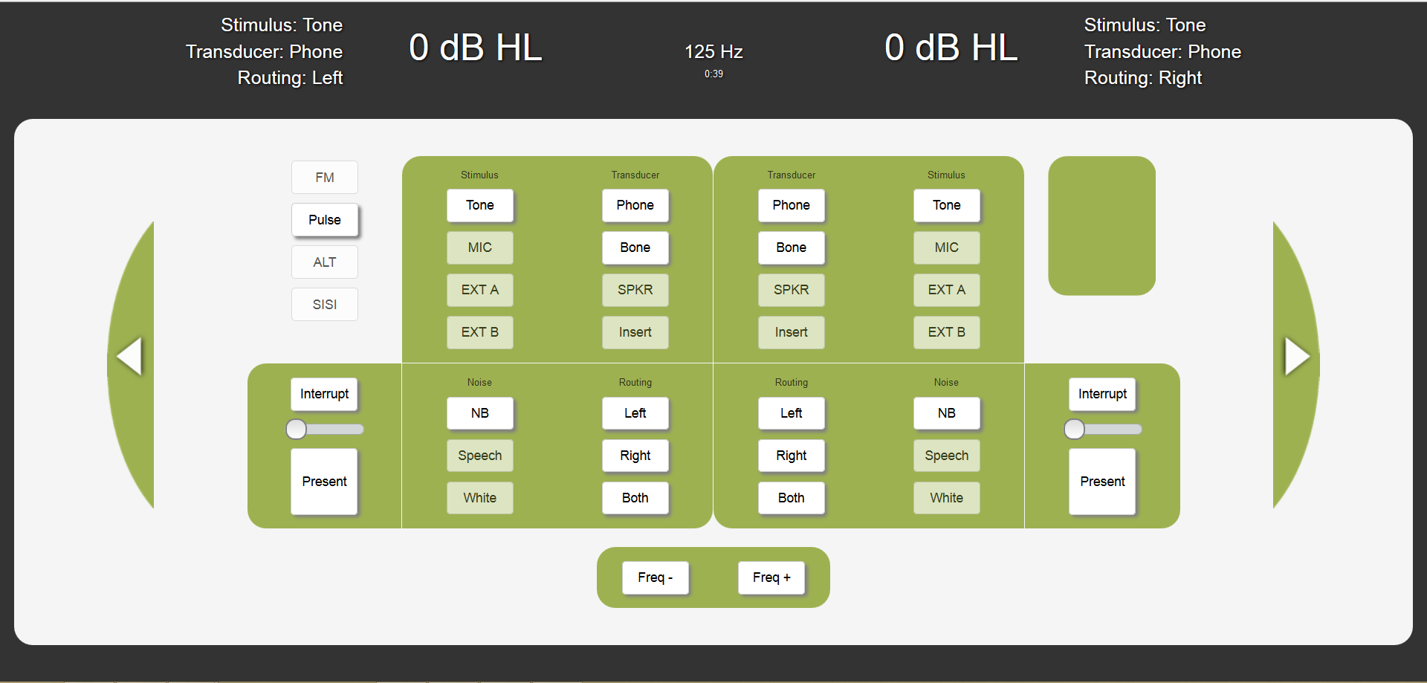
Layout changes
Removed unnecessary decibel buttons
Renamed channels
Increased header text size
Removed some header information

Slide 32
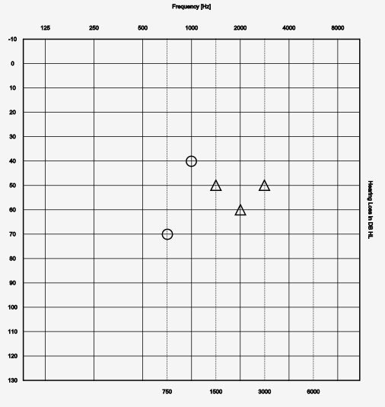
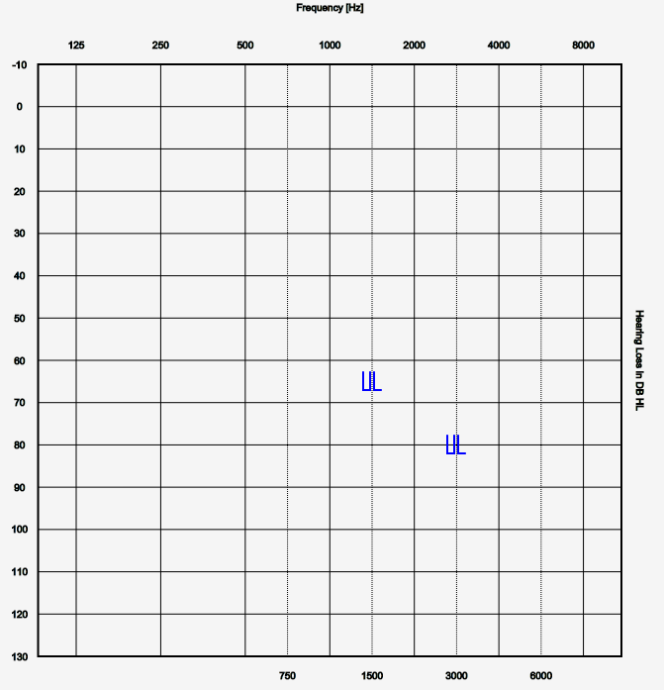
Remodel Audiogram
Original
Remodeled

Slide 33
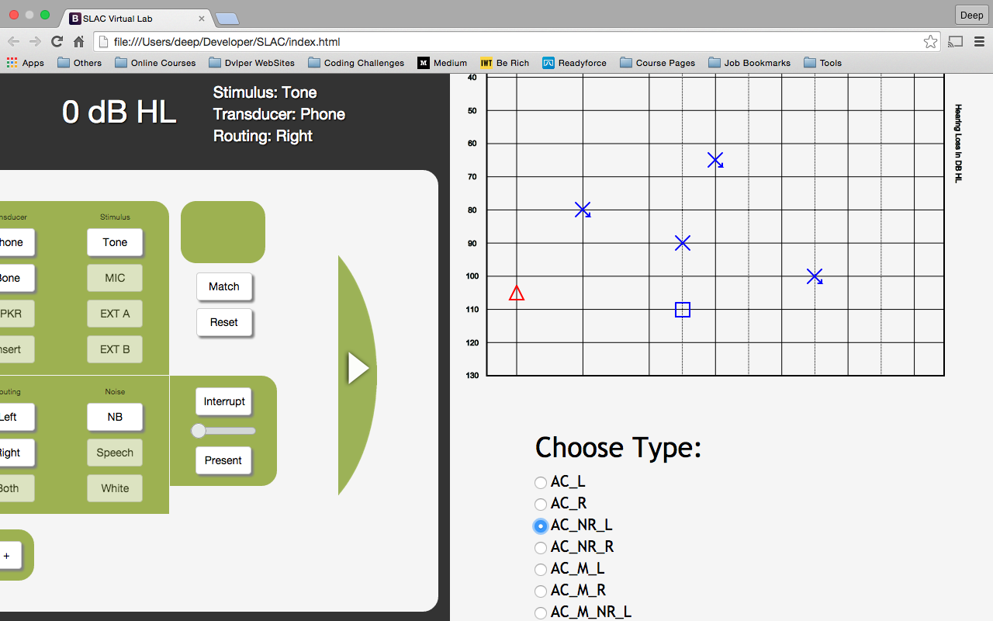
Symbol selection

Slide 34
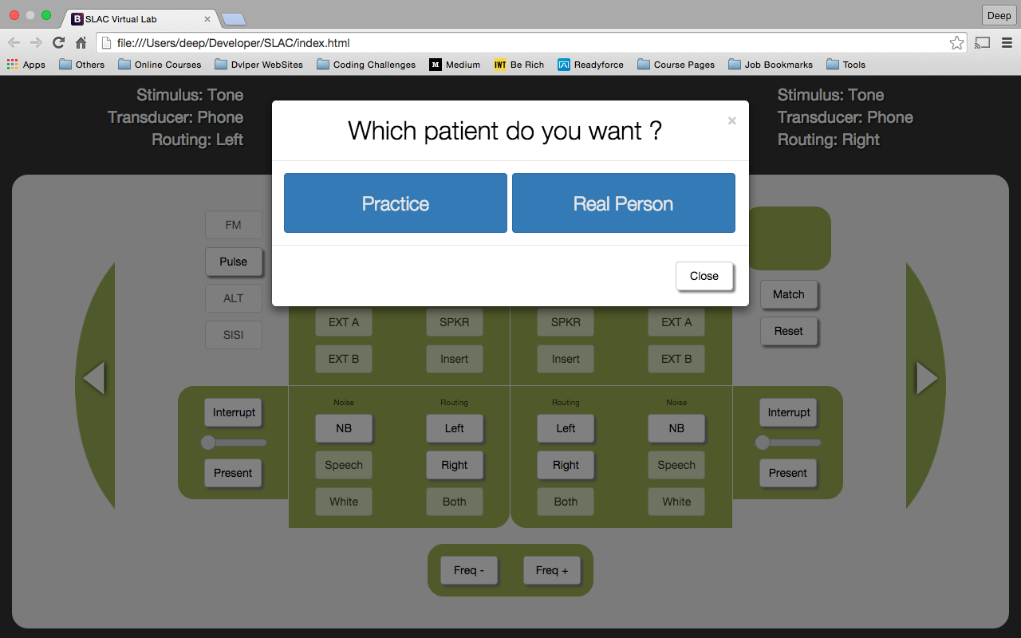

Slide 35
Currently working on:
Database input/output
Testing mode/Practice function specifications

Slide 36
Tech we’re using:
HTML5
Responsive HTML
Python
CSS
JavaScript
MySQL

Slide 37
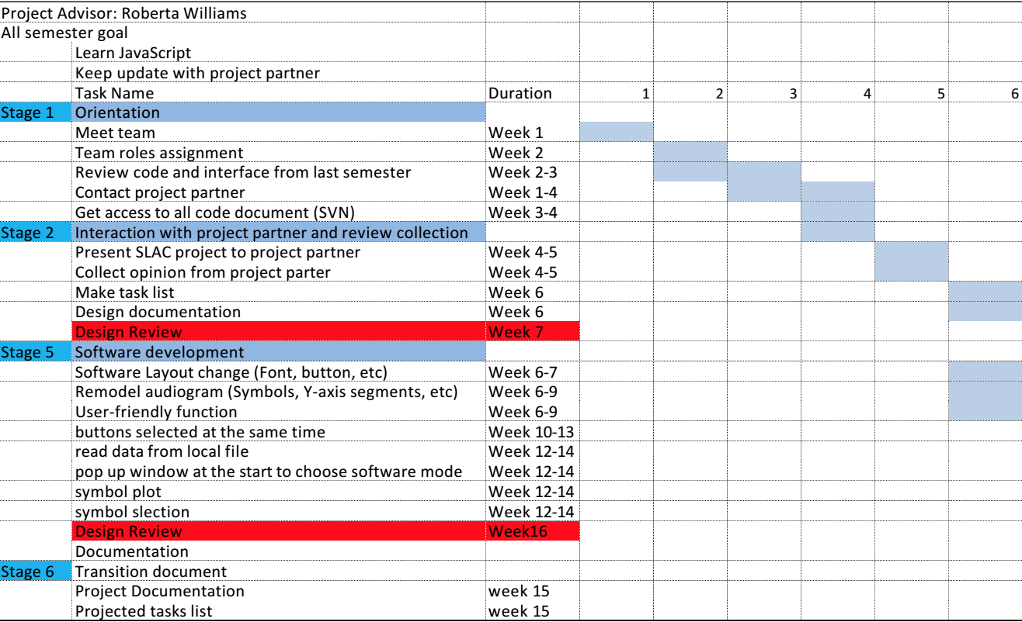
Semester Plan
Gantt Chart

Slide 38
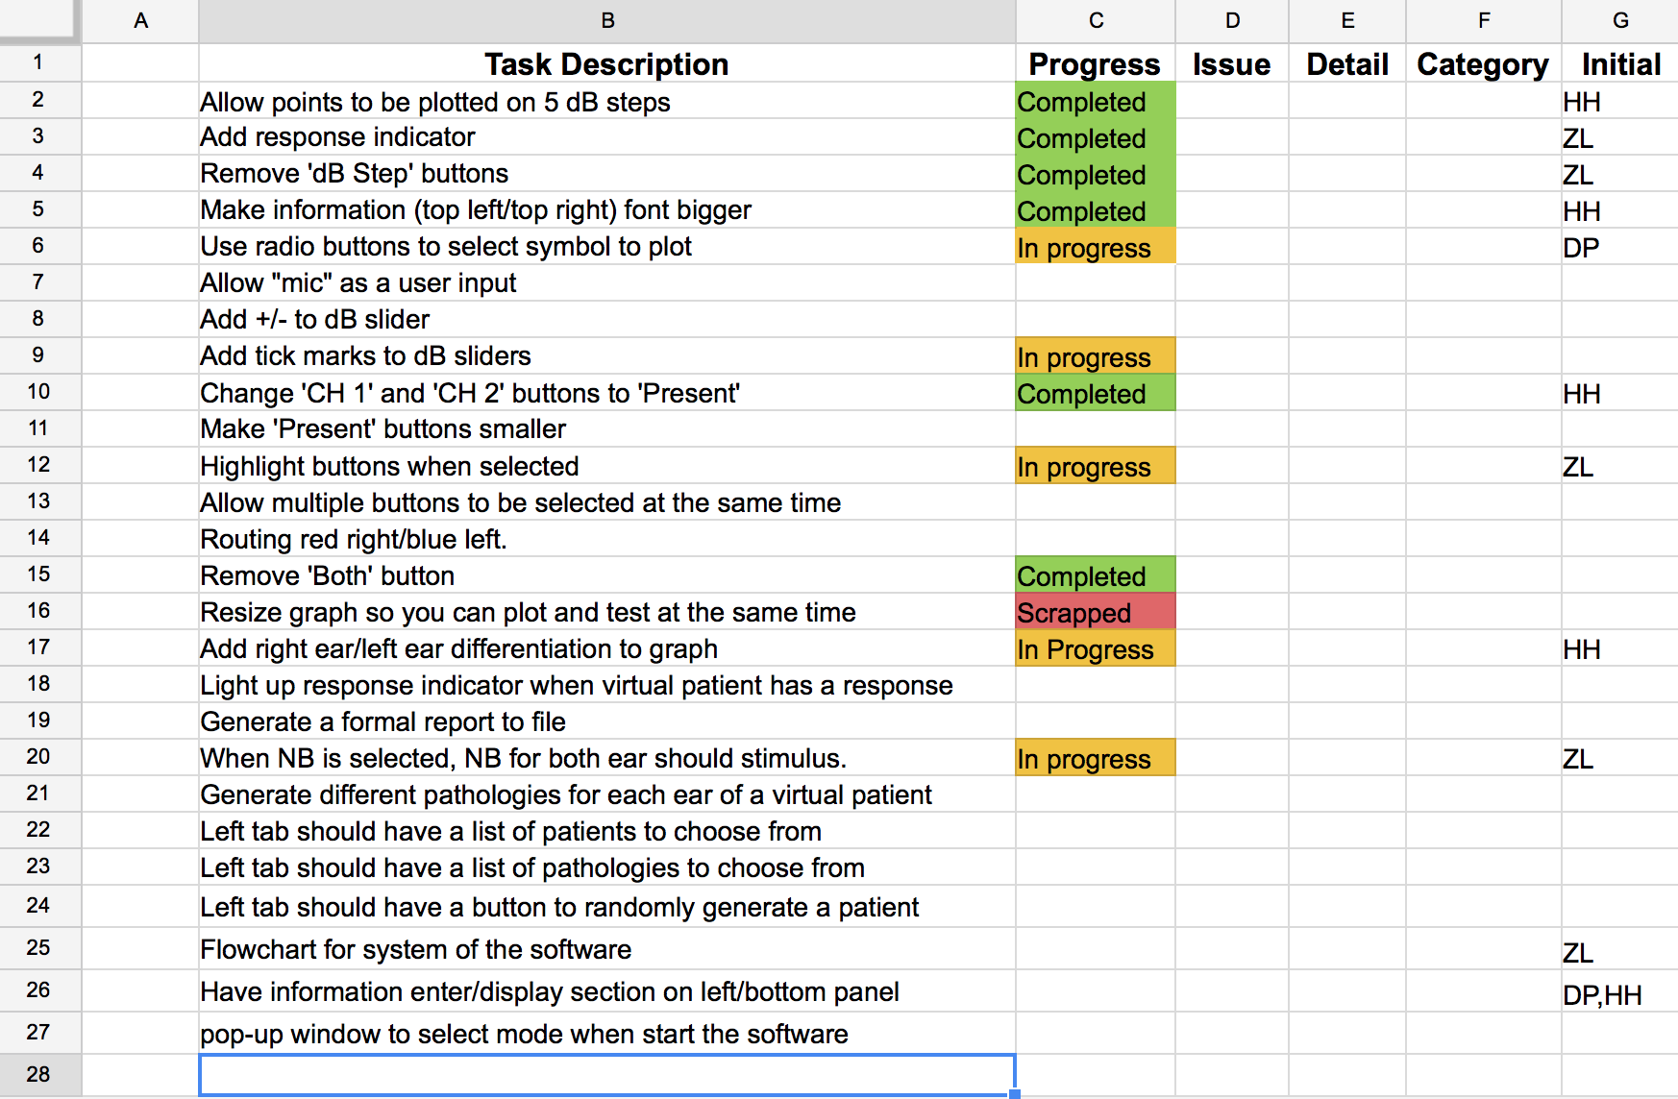
Task list

Slide 39
Future plans
Complete current tasks
Testing/Bugfixing
Virtual patient creation
Responsive design fixes
Function specification
Make database work

Slide 40
Questions and comments?

Slide 41
Dining Services Purdue Online Dining Guide (PODG)
Cameron Young
Gregory Macon
Jimmy Zhang

Slide 42
Project Partners
Dining Services, University Residences, Purdue University
Contacts:
Kari Glebe
Director of Residential Dining
klglebe@purdue.edu
Greg Minner
Director of Dining Services
gminner@purdue.edu

Slide 43
The Idea
Track the availability of spots inside the dining courts on Purdue’s campus and the length of the lines outside them at any given time.
Make it easy for the student community to figure out the fastest and most convenient place to eat
Give our project partners insight on how the dining courts are being used

Slide 44
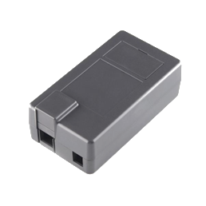
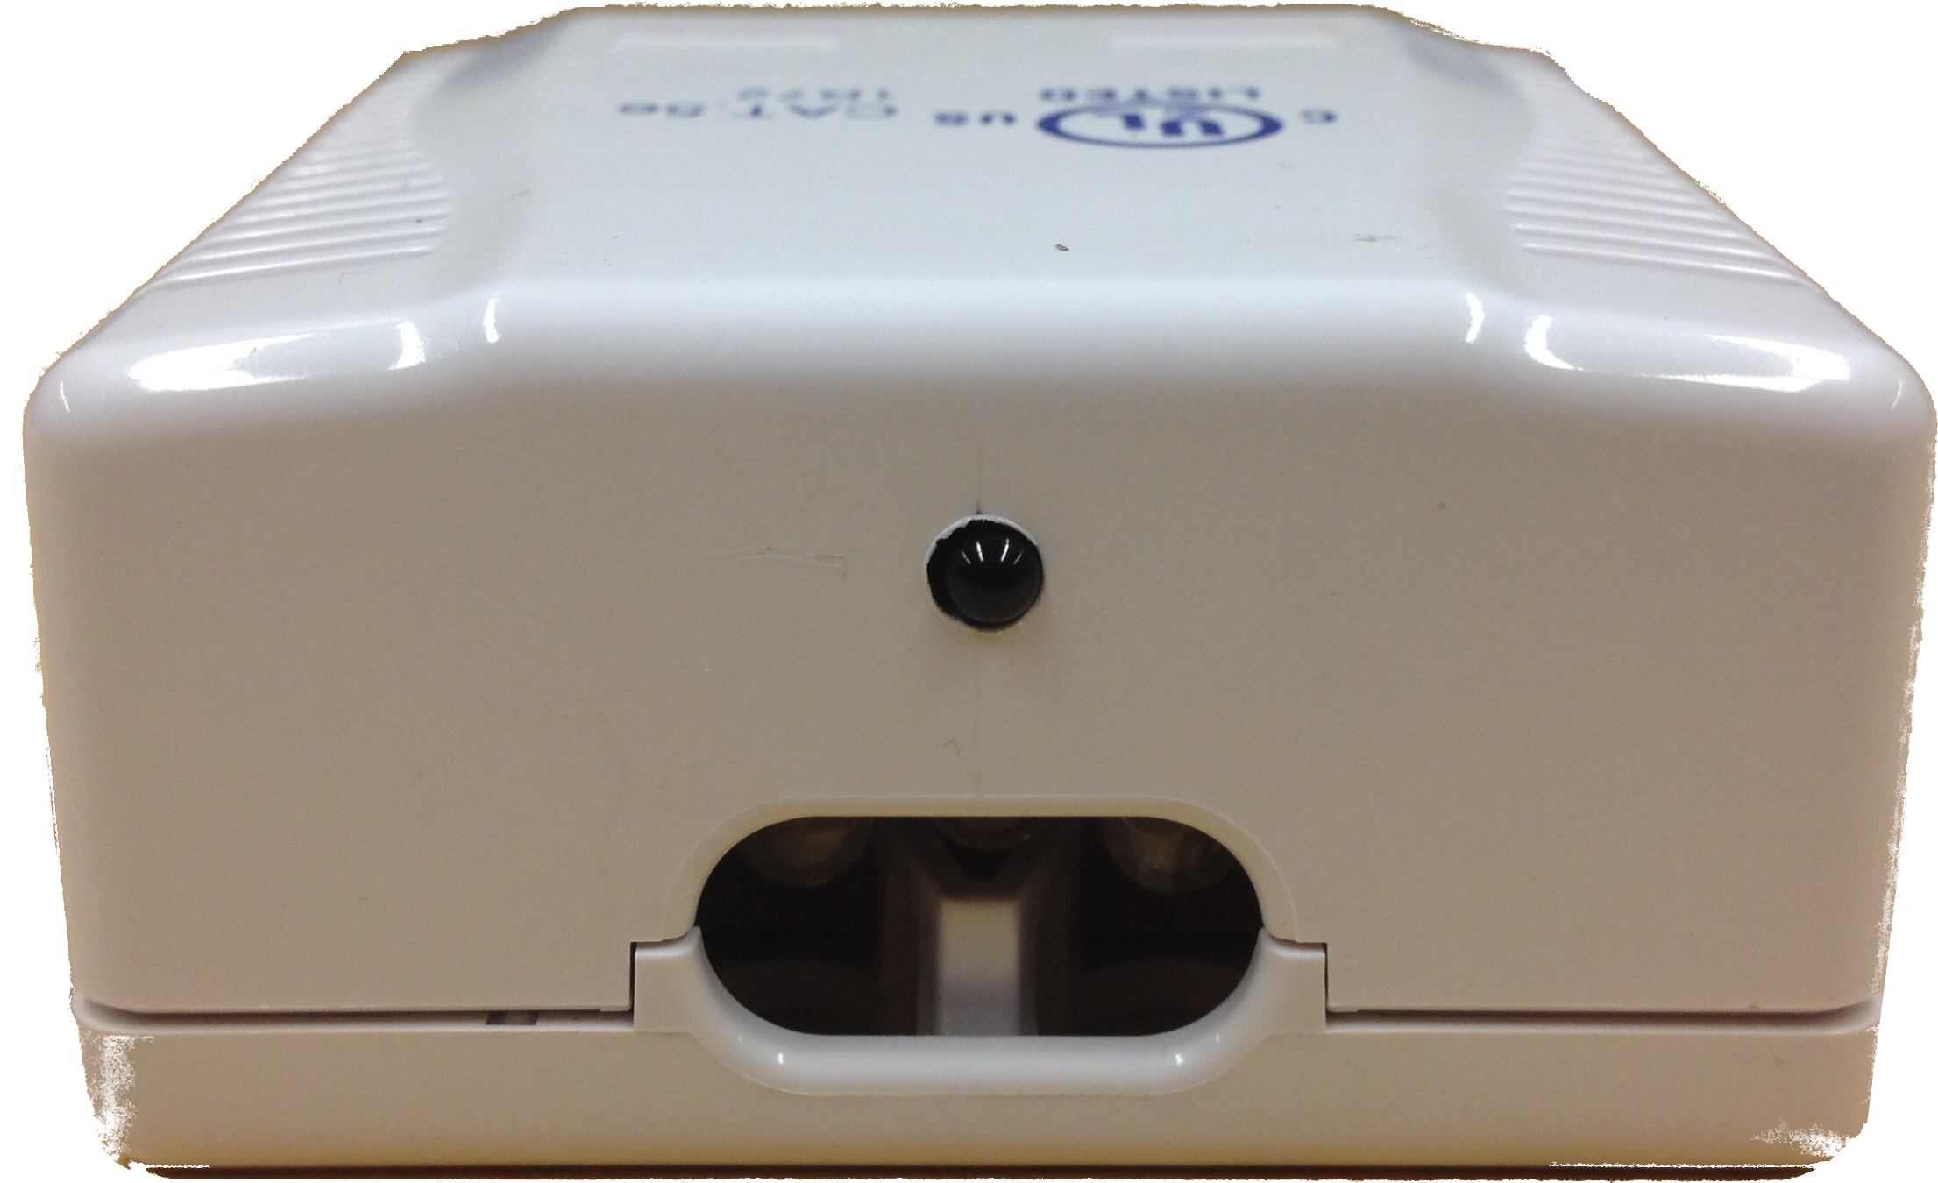
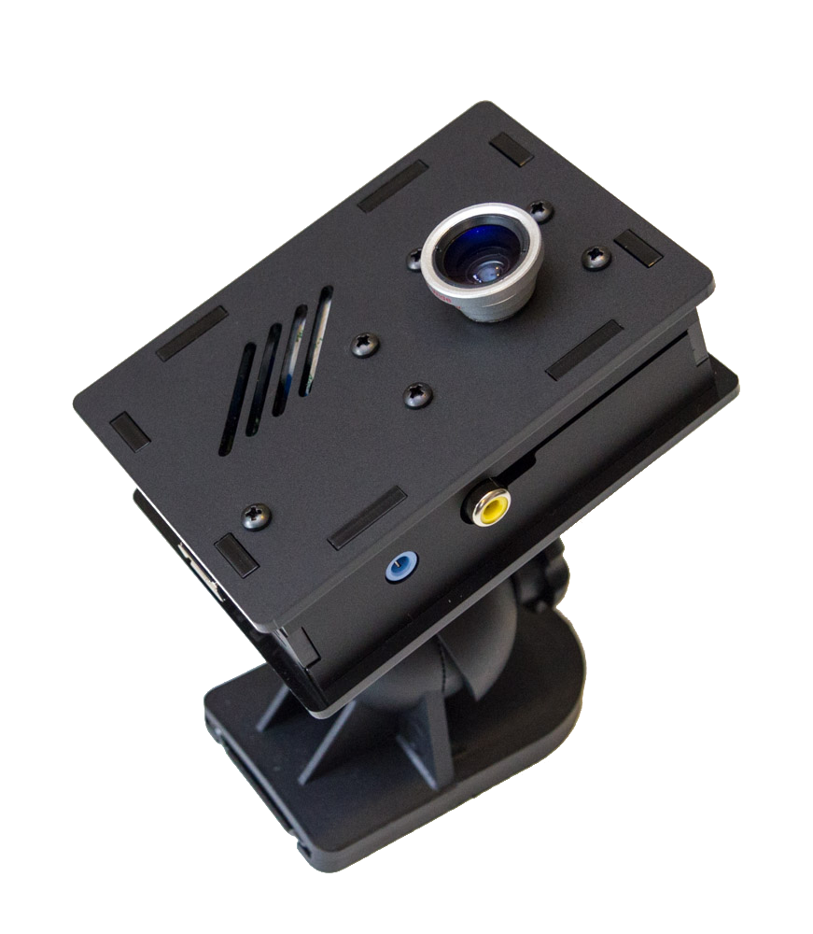
Previous Semesters
We had a functional system using infrared sensors
For higher accuracy we switched to cameras (2 have been built)

Slide 45
This Semester
New Director of Residential Dining
Blurred photo of the line
Installed 2 cameras in Earhart
Started an API for Purdue’s app to use our data
Administrative page layout

Slide 46
Semester Timeline
 | Task Name | Duration | 1 | 2 | 3 | 4 | 5 | 6 | 7 | 8 | 9 | 10 | 11 | 12 | 13 | 14 | 15
Part 1 | Orientation | 4 Weeks
Part 2 | Installation | 2 Weeks
Part 3 | Coding Phase | 8 Weeks
Part 4 | Data Collection & Verification | 7 Weeks
Part 5 | Monitoring / Minor Tweaks | 3 Weeks
Part 6 | Design Reviews & Semester Documation | Week 7, 14 - 16

Slide 47
How it Works
Each dining court has two cameras
Entrance and Exit
Track entry/exit using our camera system
Sends data to the MySQL database
Current Count
(Entrances counted) – (Exits counted)

Slide 48
System Details
Each box has a Raspberry Pi computer with a small camera and a Wi-Fi adapter
The only external wire is for power
The processing (counting) occurs on each Raspberry Pi and only the results are sent to the server

Slide 49
System Diagram
Dining Court
Purdue iTaP Server
Raspberry Pi
Administration Page
Entrance Counter
Camera
Dining Services Website
Wi-Fi Adapter
API
Raspberry Pi
RESTful API (PHP)
API
Exit Counter
Dining Services Mobile App
Camera
MySQL Database
Wi-Fi Adapter

Slide 50
First Deployment Location: Earhart
Exit
6’
Entrance
11’
5’6”
2’
5’6”
5’
4’5”
2’
Power Outlet
Card Swiper
12’6”

Slide 51
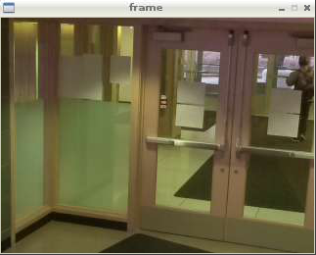
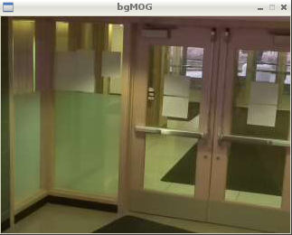
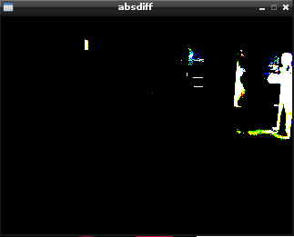
Example of Entrance Camera

Slide 52
Progress
This Semester
Have cameras updating their information in the database
Installed two cameras in Earhart dining court
Setup an administration page to display the IP addresses of the cameras

Slide 53
Problems we faced
Installation
Minimal number of wires
Had to wait for two outlets to be added in Earhart
Counting
People pacing back and forth by the exit may be counted repeatedly
Coding
No storing images
Groups of people are hard to distinguish

Slide 54
Budget
Camera System – roughly $250 per dining court (includes 2 cameras)
Each box needs:
Raspberry Pi Model B - $40
4GB SD Card - $8
Raspberry Pi Camera - $30
Raspberry Pi Camera Box w/ Wall Mount - $22
Mini USB Wi-Fi - $12
Power Adapter - $7

Slide 55
API
Provides:
IP addresses of cameras
The number of people currently inside each dining court
Will Provide:
(Possibly) a blurred image of the line
An estimate of the current wait time

Slide 56
Administration Page
Allows for updates to the dining court structure by dining services after project delivery
Includes adding new dining courts, changing hours, etc.

Slide 57
Remaining this Semester
Collect data from Earhart and tweak the software for better results
OpenCV has lots of parameters that can be tweaked
Complete the API for accessing the data
Update the Administration page to demo the API

Slide 58
Next Semester
Compare entrance count to card swipe data
Complete API
Install in other dining courts
Add examples of the API to the Administration page

Slide 59
Thank You
Questions?
Comments?

Slide 60
EPICS Explorer
Yoselyn Walsh
Naveen Ganessin
Zach Simpson
Logan Fuller

Slide 61
EPICS Explorer
Project Partner
Pam Brown EPICS Program Coordinator
Goal
To provide a portal for incoming EPICS students to choose the EPICS team that is best suited for their major/interest.

Slide 62
The goal
Provide an application which would be able to modify and update the information about the teams and projects of Epics.

Slide 63
Our additional goals
Provide an application:
Presentable
Navigable
Updatable

Slide 64
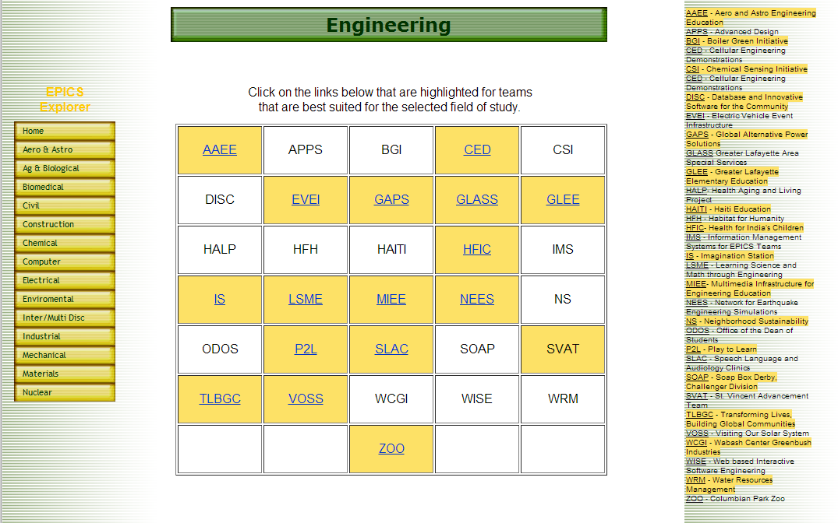
Previous Website

Slide 65
Specifications
HTML5
CSS3
PHP5
JavaScript
MySQL
Jquery
Bootstrap

Slide 66
Site map

Slide 67
Epics Explorer
Schools
All teams
Teams
Team
Skills

Slide 68
Team
General information
Name
Acronym
Team Information
TA
Instructor
Website
Description
Projects
Epics Explorer
Schools
All teams
Teams
Skills

Slide 69
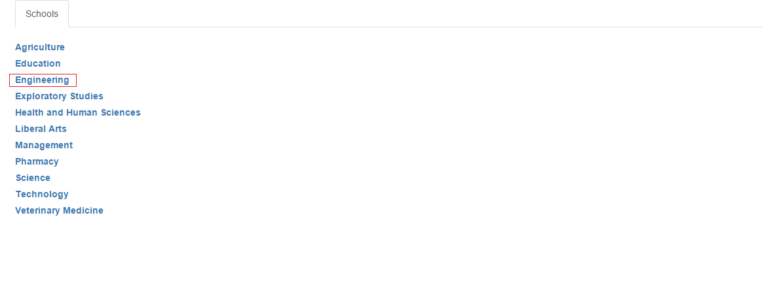
Schools

Slide 70
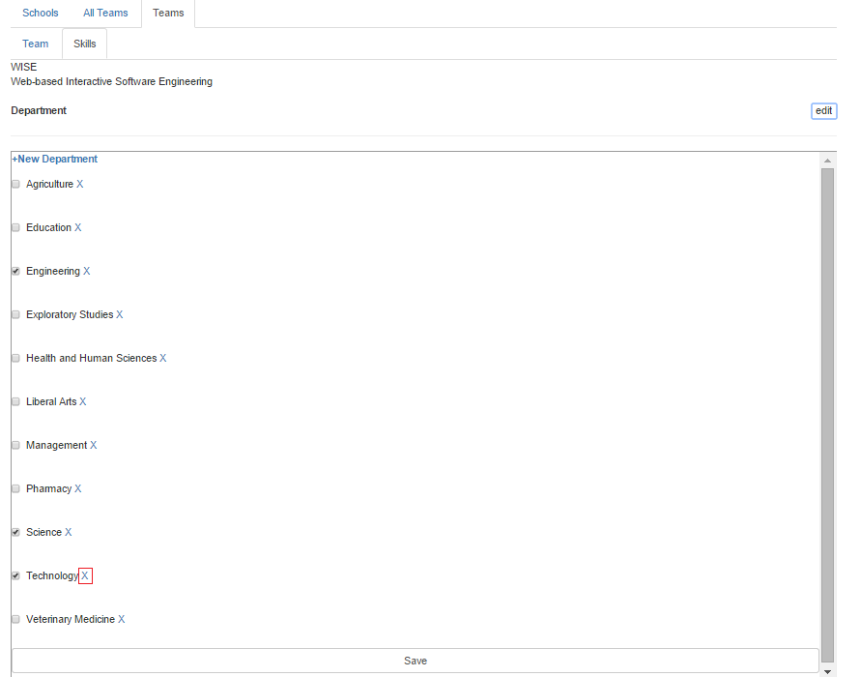
Delete department

Slide 71
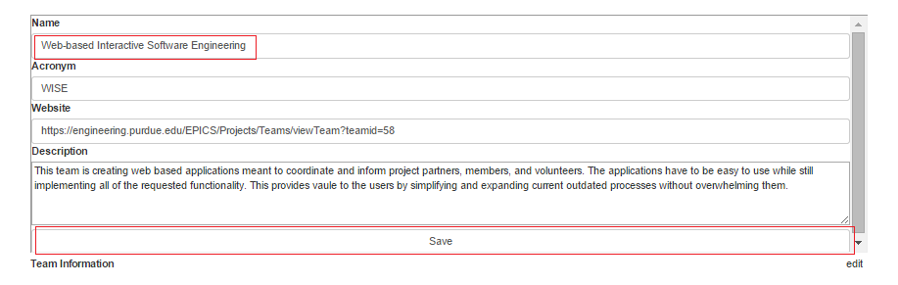
Edit

Slide 72
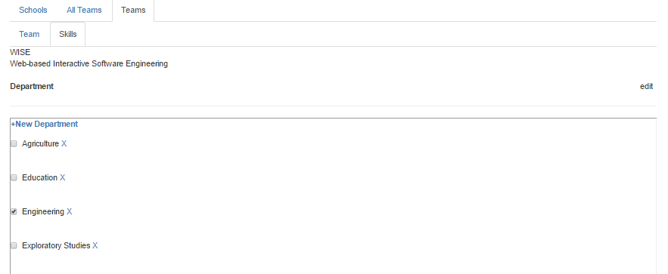
Department per team

Slide 73
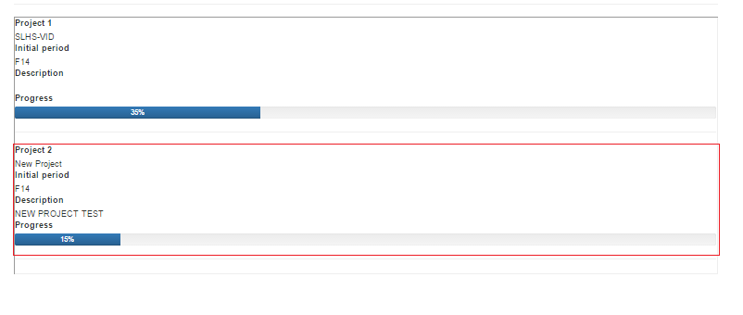
Team projects

Slide 74
Demo

Slide 75
The Next Step…
Current and prospective students module
Test
Fix bugs

Slide 76
Thank You! Questions and Comments?

